Slide 1
Probabilistic reasoning - 2

Slide 2
Agenda
Review
Bayesian Network
Markov Blanket
Conditional Independence
HMM – Introduction
Components of HMM
HMM Assumptions
HMM- three fundamental problems
Likelihood Computation: The Forward Algorithm
Decoding: The Viterbi Algorithm
HMM Training: The Forward-Backward Algorithm

Slide 3
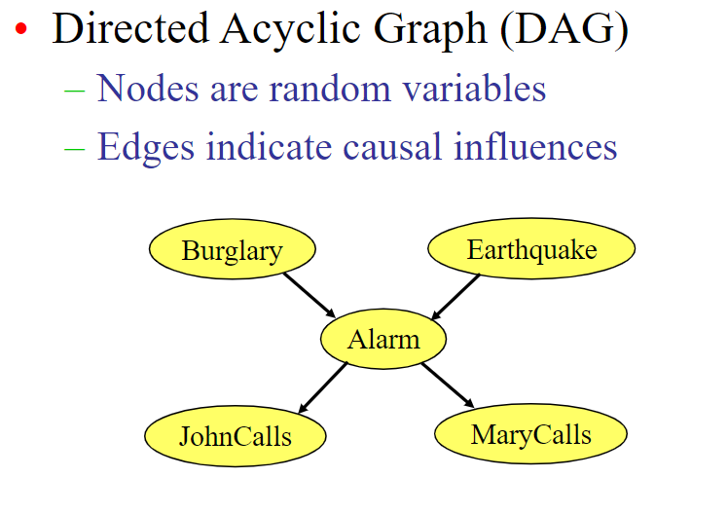
Bayesian Network

Slide 4
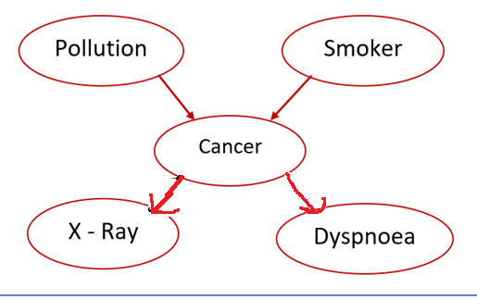
Bayesian Network : Structure terminology
Node is a parent of a child, if there an arc from the former to the later
For a directed chain of nodes, one node is an ancestor of another, if it appears earlier in the chain, whereas a node is a descendant of another node if it comes later in the chain
Cancer node has two parents, Pollution and Smoker, while Smoker is an ancestor of both X- Ray and Dyspnoea
X Ray is a child of Cancer and descendant of Smoker and Pollution

Slide 5
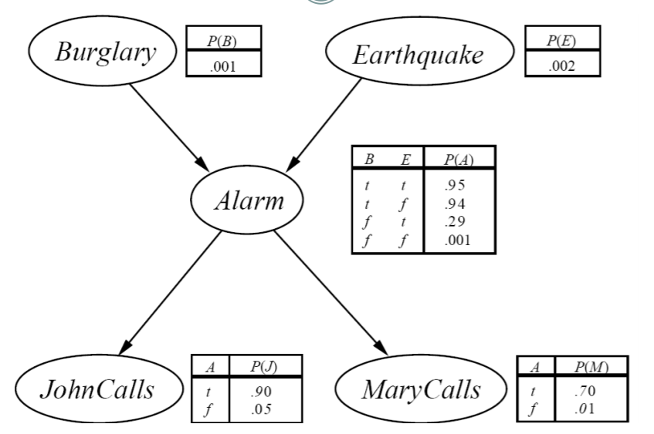
Bayesian Network
A Bayesian Network is a graph in which each node is annotated with probability information. The full specification is as follows
B, E, J ,M, A are binary variables
A set of random variables makes up the nodes of the network
Conditional Probability tables are given for each node.
No of parameters needed to represent the Bayesian network = Number of CPT entries in the network = 1+1+4+2+2=10
Bayesian network with
(maximum in-degree k ) = n x 2^{k} variables

Slide 6
Conditional Independence
An important concept for probability distributions over multiple variables is that of conditional independence
p(a, b|c) = p(a|b, c)p(b/c) = p(a|c)p(b|c)
Conditional independence properties play an important role in using probabilistic models for pattern recognition by simplifying both the structure of a model and the computations needed to perform inference and learning under that model.
The general framework for achieving this is called d-separation, where the ‘d’ stands for ‘directed’

Slide 7
Example
Flip two fair coins.
A : Event that the first coin is heads
B: Event that the second coin is heads,
C : Event that the two coins are the same (both heads or both tails).
→ A and B are independent,
But
→ but they are not conditionally independent given C
i.e., if you know that C has happened, then knowing A tells you a lot about B

Slide 8
Conditional Independence
The relationship between conditional independence and Bayesian network structure is important for understanding how Bayesian networks work
1. Casual chains
2. Common Causes
3. Common Effects
4. D- Separation

Slide 9
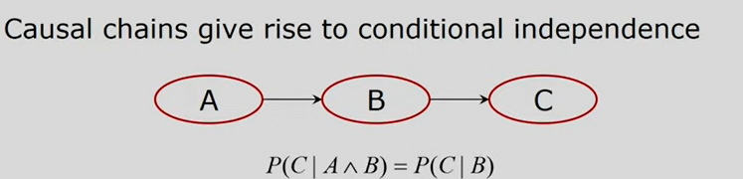
Causal chains
The probability of C given B is exactly same as probability of C, given both B an A. Knowing that A has occurred does not make any difference to our belief about C of we know that B has occurred

Slide 10
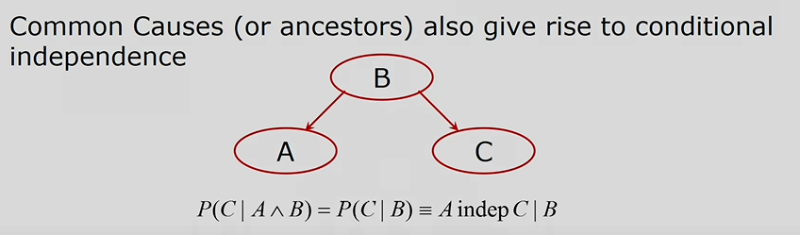
Common causes

Slide 11
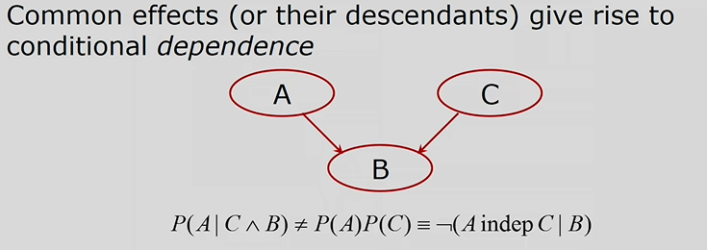
Common effects

Slide 12
D – Separation
Two nodes are d-separated
- if every undirected path between them is cut off
Two sets of nodes are d-separated
- If every pair of nodes, one from each set, is d- separated
Two sets of nodes are independent
- If they are d- separated

Slide 13
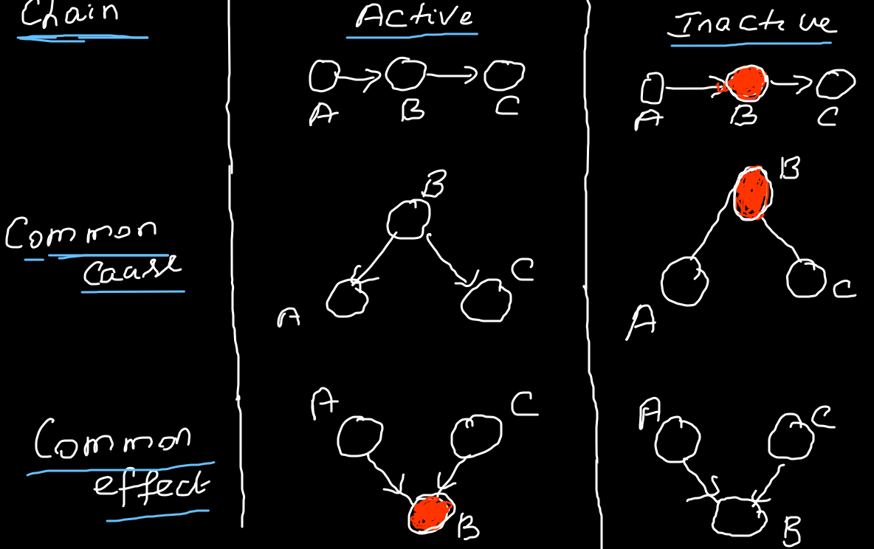

Slide 14
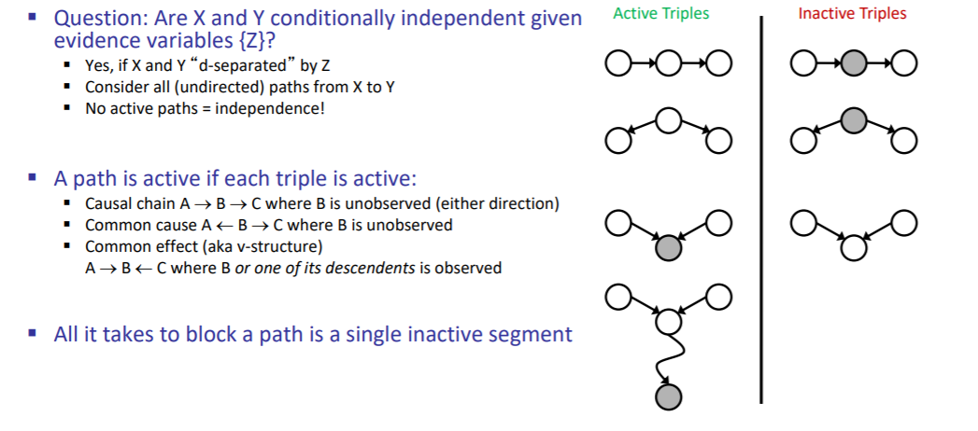
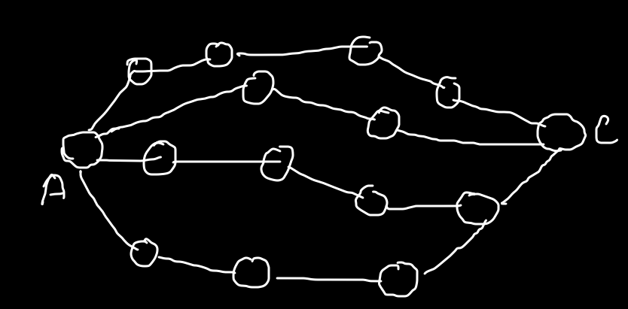

Slide 15
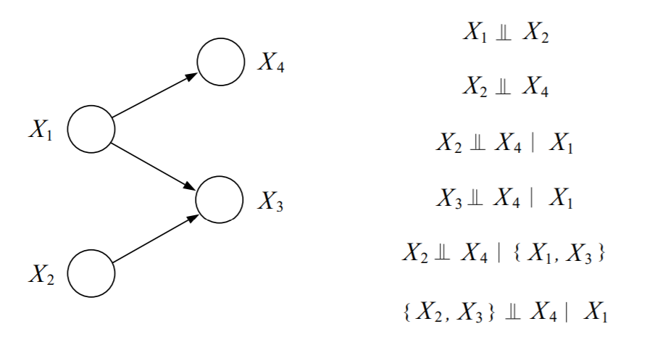
Example

Slide 16
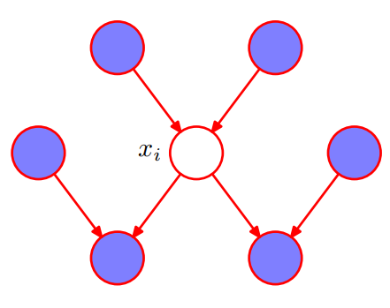
Structure terminology - Markov Banket
Markov Blanket of a node is a set consists of
node’s parents,
its children,
its children’s parents

Slide 17
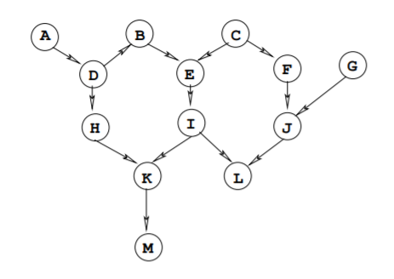
Markov blanket of node ‘I’ is { E, H, J, K, L}

Slide 18
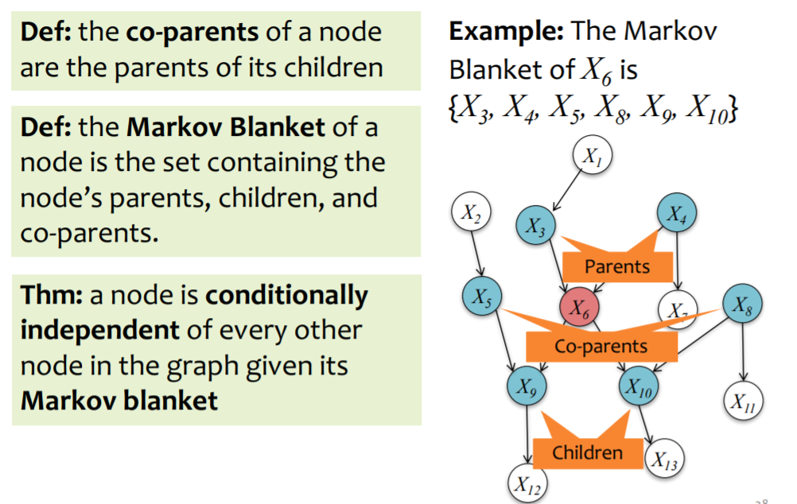
Markov Blanket

Slide 19
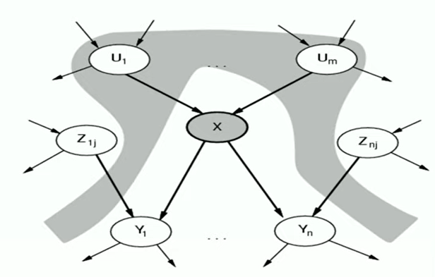
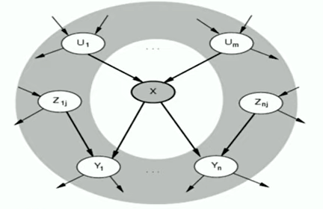
Given its parents, X is independent of all its non- descendants
Given Markov blanket, X is independent of all other nodes

Slide 20
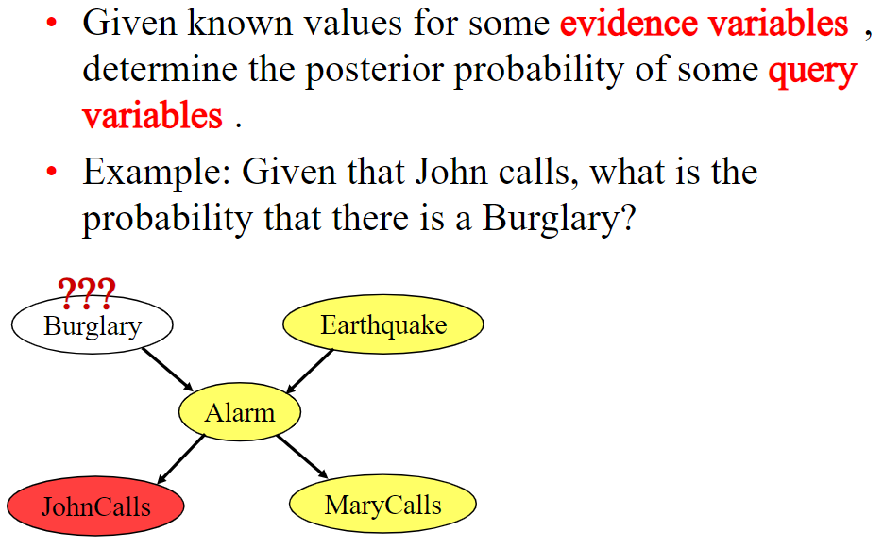
Bayesian Inference

Slide 21
Inference in Bayesian Network
Exact Inference
Enumeration
Variable Elimination Algorithm
Give that exact inference is intractable in large networks. It is essential to consider approximate inference models
Approximate Inference
Discrete sampling method
Rejection sampling method
Likelihood weighting
MCMC algorithms

Slide 22
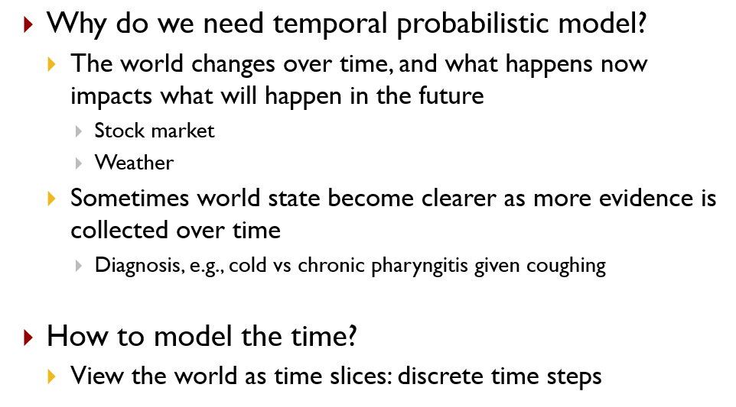
Probabilistic Reasoning over time

Slide 23
Time and Uncertainty
Treating a diabetic patient.
Evidence - recent insulin doses, food intake, blood sugar measurements, and other physical signs.
Task - to assess the current state of the patient -actual blood sugar level and insulin level.
Decision - patient’s food intake and insulin dose.
Dynamic aspects of the problem : Blood sugar levels and measurements can change rapidly over time, depending on recent food intake and insulin doses, metabolic activity, the time of day, and so on.
We must model these changes - To assess the current state from the history of evidence and to predict the outcomes of treatment actions

Slide 24


Transition and Sensor model
How the world evolves (the transition model)
How the evidence variables get their values (the sensor model).
The transition model specifies the probability distribution over the latest state variables, given the previous values, that is,
P(X_{t} | X_{0:t−1})
Markov Assumption
Sensor Markov Assumption

Slide 25
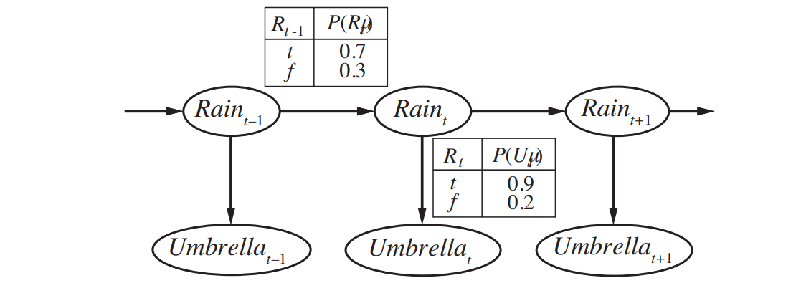
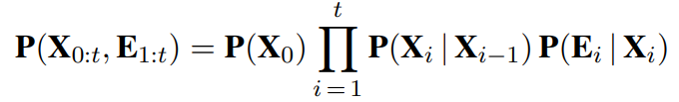
Transition and Sensor model
Example: You are the security guard stationed at a secret underground installation. You want to know whether it’s raining today, but your only access to the outside world occurs each morning when you see the director coming in with, or without, an umbrella.

Slide 26
Inference in Temporal models
Filtering: This is the task of computing the belief state—the posterior distribution over the most recent state—given all evidence to date - also called state estimation.
i.e, compute P(Xt | e1:t)
In the umbrella example - computing the probability of rain today, given all the observations of the umbrella carrier made so far
Prediction: This is the task of computing the posterior distribution over the future state, given all evidence to date.
i.e., compute P(Xt+k | e1:t) for some k > 0.
In the umbrella example, this might mean computing the probability of rain three days from now, given all the observations to date.

Slide 27
Inference in Temporal models
Smoothing: This is the task of computing the posterior distribution over a past state, given all evidence up to the present.
i.e., compute P(X_{k}|e1:t) for some k such that 0 ≤ k<t.
In the umbrella example - computing the probability that it rained last Wednesday, given all the observations of the umbrella carrier made up to today
Most likely explanation: Given a sequence of observations, the task of finding the sequence of states that is most likely to have generated those observations.
i.e., compute argmax_{x1:t} P(x_{1:t} | e_{1:t}).
For example, if the umbrella appears on each of the first three days and is absent on the fourth, then the most likely explanation is that it rained on the first three days and did not rain on the fourth.

Slide 28
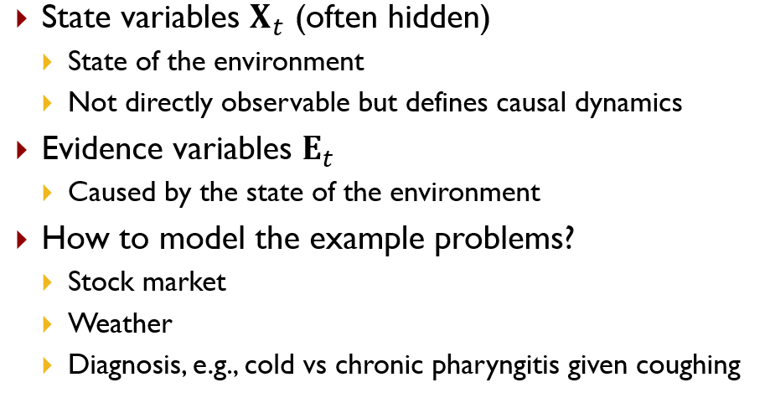
Hidden Markov model, Dynamic Bayesian network, Kalman filtering

Slide 29
Why HMM?
A Markov chain is useful when we need to compute a probability for a sequence of observable events.
In many cases, however, the events we are interested in are hidden
we don’t observe them directly. For example we don’t normally observe part-of-speech tags in a text.
Rather, we see words, and must infer the tags from the word sequence. We call the tags hidden because they are not observed.
Example: You are the security guard stationed at a secret underground installation. You want to know whether it’s raining today, but your only access to the outside world occurs each morning when you see the director coming in with, or without, an umbrella.

Slide 30
What is an HMM?
Graphical Model - circles indicate states - arrows indicate probabilistic dependencies between states
Stochastic model where the states of the model are hidden
Each state can emit an output which is observed
A temporal probabilistic model

Slide 31
What is an HMM?
Green circles are hidden states
Dependent only on the previous state
“The past is independent of the future given the present.”

Slide 32
What is an HMM?
Purple nodes are observed states
Dependent only on their corresponding hidden state

Slide 33
HMM Formalism
S
S
S
S
S
O
O
O
O
O
{S, O, Π, Α, Β}
S : {s₁…s_{N} } are the values for the hidden states
O : {o₁…o_{M} } are the values for the observations

Slide 34
HMM Components
A
A
A
A
S
S
S
S
S
B
B
B
O
O
O
O
O
{S, O, Π, Α, Β}
S = Set of hidden sates
O = set of possible visible outcomes
Π = {π_{ι}} are the initial state probabilities
A = {a_{ij}} are the state transition probabilities
B = {b_{io}} are the observation state probabilities

Slide 35
Example
0.3
0.7
Low
High
0.2
0.8
0.6
0.6
0.4
0.4
Rain
Dry
Two states : Low and High atmospheric pressure.
Two observations : Rain and Dry

Slide 36
Two states : Low and High atmospheric pressure.
Two observations : Rain and Dry
Initial probabilities
P(low)=0.4
P(high)=0.6
0.3
0.7
Low
High
0.2
0.8
0.6
0.6
0.4
0.4
Transition probabilities
P(Low | Low)=0.3
P(High | Low)=0.7
P(Low | High)=0.2
P(High | High)=0.8
Observation probabilities
P(Rain | Low)=0.6
P(Dry | Low)=0.4
P(Rain | High)=0.4
P(Dry | High)=0.3
Rain
Dry

Slide 37
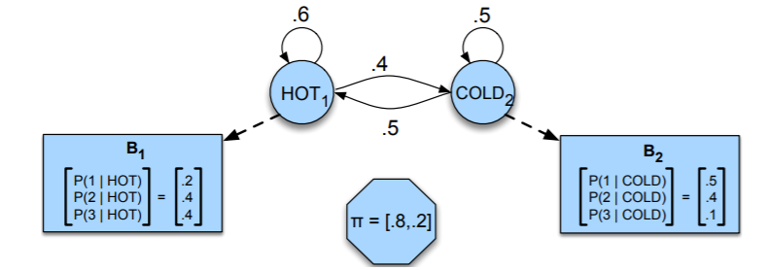
Example 1
A hidden Markov model for relating numbers of ice creams eaten by Jason (the observations) to the weather (H or C, the hidden variables).
A sample HMM for the ice cream task.
The two hidden states (H and C) correspond to hot and cold weather
Observations (drawn from the alphabet O = {1,2,3}) correspond to the number of ice creams eaten by Jason on a given day.

Slide 38
Inference in an HMM- Central problems in HMM
1. Compute the probability of a given observation sequence
2. Given an observation sequence, compute the most likely hidden state sequence
3. Given an observation sequence and set of possible models, which model most closely fits the data?

Slide 40
Central problems in HMM modelling
Evaluation
Given parameters and observation sequence, find probability (likelihood) of observed sequence - forward algorithm
Decoding
Given HMM parameters and observation sequence, find the most probable sequence of hidden states generated the given observations - Viterbi algorithm
Learning
Given HMM with unknown parameters and observation sequence, find the parameters that maximizes likelihood of data - Forward-Backward algorithm

Slide 41
Evaluation
Given the HMM M=(A, B, π) and the observation sequence O = o1 o2 ... ok , calculate the probability that model M has generated sequence O
Trying to find probability of observations O = o1 o2 ... ok by means of considering all hidden state sequences is impractical
N^{k} hidden state sequences - exponential complexity.
Use Forward HMM algorithms for efficient calculation

Slide 42
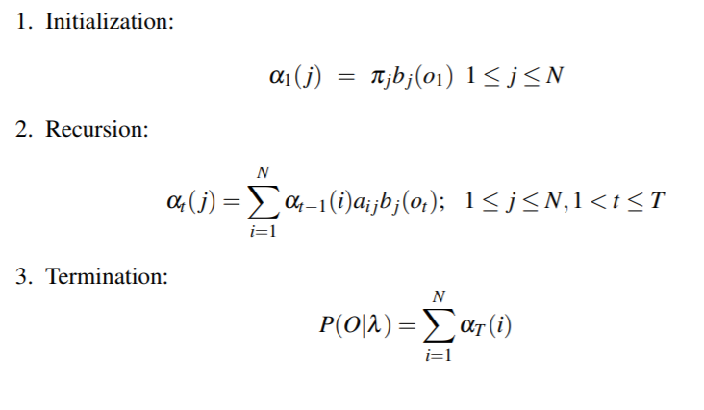
Forward algorithm
α_{t−1}(i) → previous forward path probability from the previous time step
a_{i,j} → transition probability from previous state q_{i} to current state q_{j}
b_{j}(o_{t}) → state observation likelihood of the observation symbol o_{t} given the current state j

Slide 43
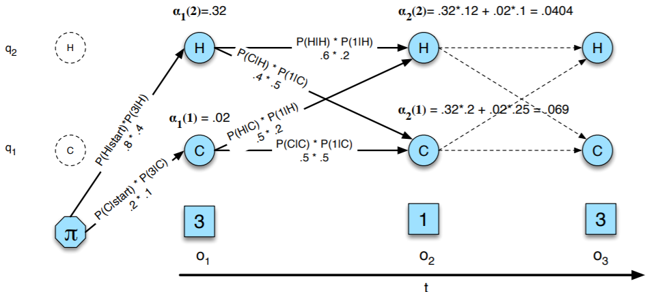

The forward trellis for computing the total observation likelihood for the ice-cream events 3 1 3
Hidden states are in circles, observations in squares
The figure shows the computation of α_{t}(j) for two states at two time steps.
The computation in each cell follows

Slide 44
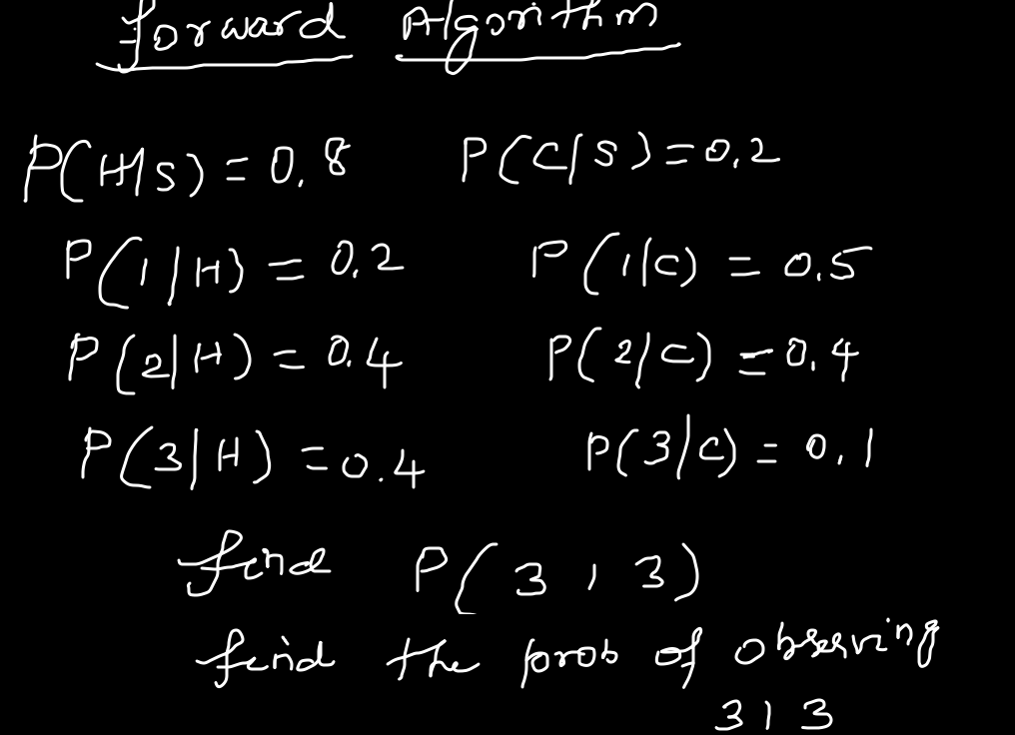
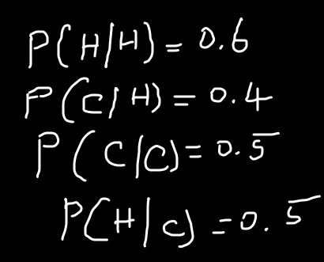

Slide 46
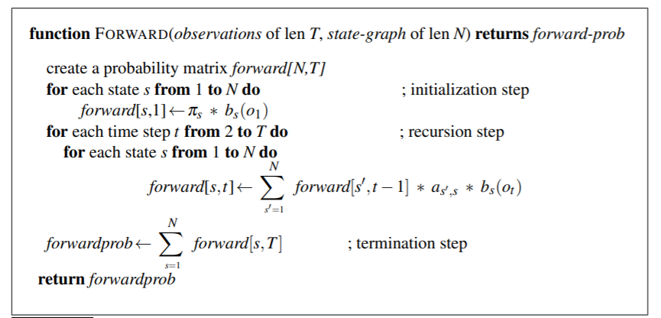
Forward Algorithm

Slide 47
Decoding
The process of discovering the sequence of hidden states, given the sequence of observations, is known as decoding or inference.
The Viterbi algorithm is commonly used for decoding.

Slide 48
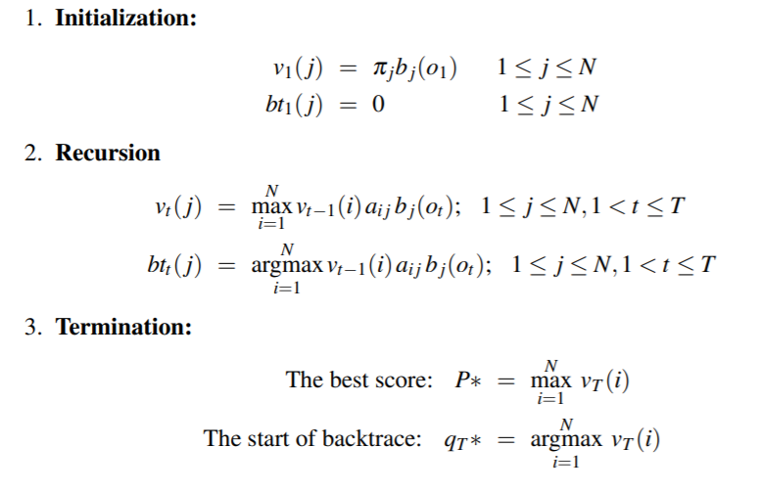
v_{t−1}(i) → previous Viterbi path probability from the previous time step
a_{ij} → transition probability from previous state qi to current state q_{j}
b_{j}(o_{t}) → state observation likelihood of the observation symbol ot given the current state j

Slide 49
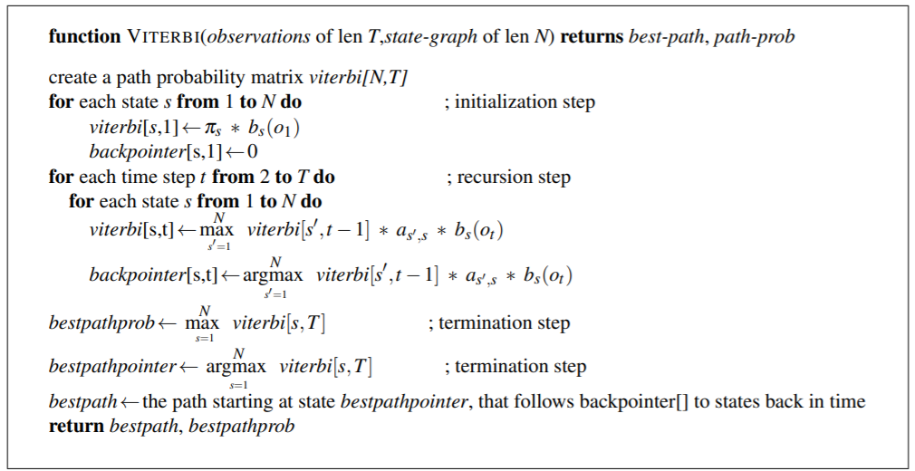
Viterbi algorithm

Slide 50
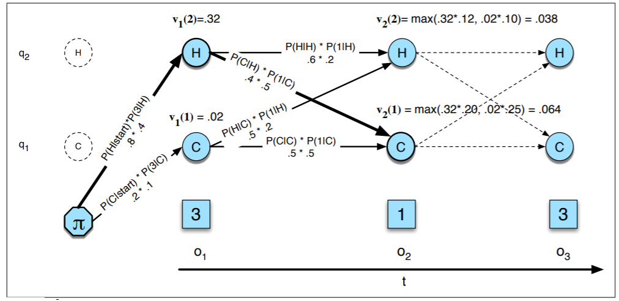
The Viterbi trellis for computing the best path through the hidden state space for the ice-cream eating events 3 1 3
Hidden states are in circles, observations in squares.
The figure shows the computation of v_{t}(j) for two states at two time steps.
The computation in each cell follows

Slide 51
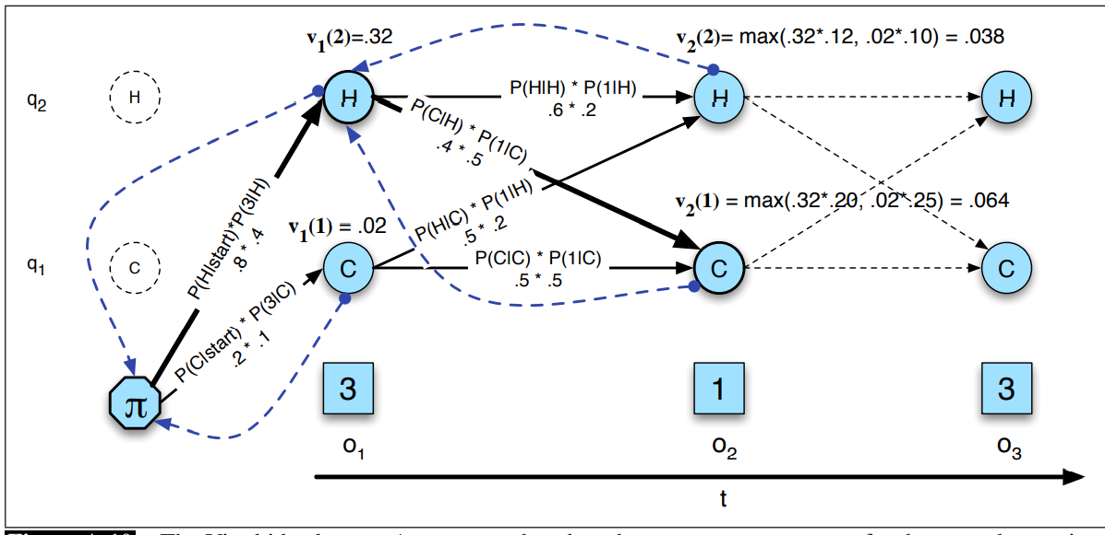
The Viterbi back-trace. As we extend each path to a new state account for the next observation, we keep a back pointer (shown with broken lines) to the best path that led us to this state

Slide 52
Difference between Forward algorithm and Viterbi
Viterbi algorithm is identical to the forward algorithm except that it takes the max over the previous path probabilities whereas the forward algorithm takes the sum.
Viterbi algorithm has one component that the forward algorithm doesn’t have back-pointers.
The reason is that while the forward algorithm needs to produce an observation likelihood, the Viterbi algorithm must produce a probability and also the most likely state sequence.
We compute this best state sequence by keeping track of the path of hidden states that led to each state and then at the end back tracing the best path to the beginning (the Viterbi back trace).

Slide 53
HMM Applications
Generating parameters for n-gram models
Tagging speech
Speech recognition

